Slide 1
Design and Analysis of Algorithms
Merge Sort & Recurrence Relation
Spring 2022
National University of Computer and Emerging Sciences, Islamabad

Slide 2
Merge sort
The merge sort algorithm closely follows the divide-and-conquer paradigm. Intuitively,
it operates as follows.
Divide: Divide the n-element sequence to be sorted into two subsequences of n=2 elements each.
Conquer: Sort the two subsequences recursively using merge sort.
Combine: Merge the two sorted subsequences to produce the sorted answer.

Slide 3
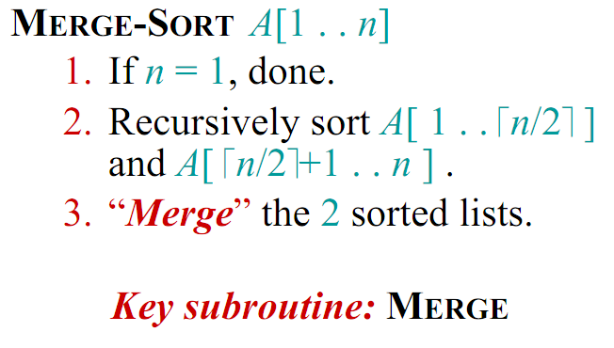
Merge Sort (Divide and Conquer)

Slide 4
Key Operation
The key operation of the merge sort algorithm is the merging of two sorted sequences in the “combine” step.
We merge by calling an auxiliary procedure
MERGE (A, p, q, r), where A is an array and p, q, and r are indices into the array such that p≤ q < r.
The procedure assumes that the subarrays A[p..q] and A[q+1.. r] are in sorted order.
It merges them to form a single sorted subarray that replaces the current subarray A[p..r]

Slide 5
Visualization MergeSort
https://opendsa-server.cs.vt.edu/embed/mergesortAV

Slide 6
Example
Partition into lists of size n/2
[10, 4, 6, 3, 8, 2, 5, 7]
[10, 4, 6, 3]
[8, 2, 5, 7]
[10, 4]
[6, 3]
[8, 2]
[5, 7]
[4] [10]
[3][6]
[2][8]
[5][7]

Slide 7
Example Cont’d
Merge
[2, 3, 4, 5, 6, 7, 8, 10 ]
[3, 4, 6, 10]
[2, 5, 7, 8]
[4, 10]
[3, 6]
[2, 8]
[5, 7]
[4] [10]
[3][6]
[2][8]
[5][7]

Slide 8
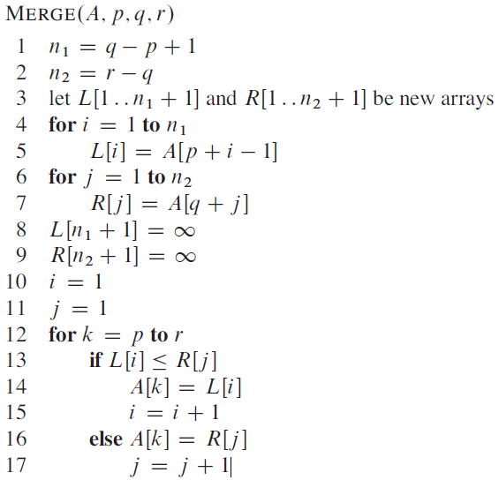
Reference: Pg#31
Introduction to algorithms

Slide 9
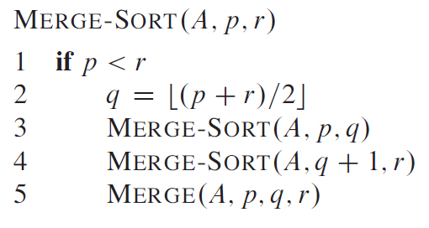
Merge-Sort

Slide 10
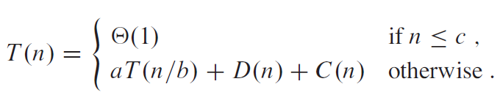
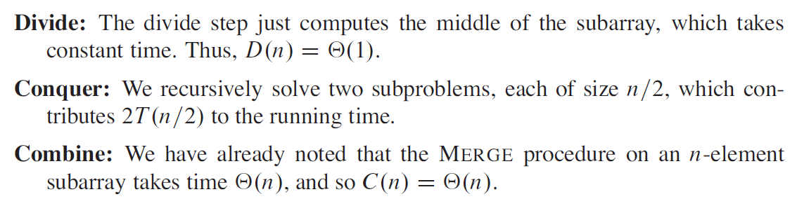
Analysis of Merge Sort

Slide 11
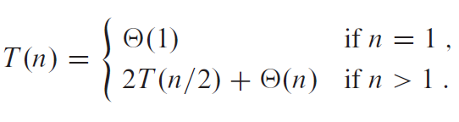
Worst-case running time T(n) of Merge sort:
Merge sort, with its θ (n lg n) running time, outperforms insertion sort, whose running time is θ (n²), in the worst case.

Slide 12
Analysis of Merge Sort
?

Slide 13
Recurrences
The expression: is a recurrence.
Recurrence: an equation that describes a function in terms of its value on smaller functions

Slide 14
Recurrence Examples

Slide 15
Example
Function(int number)
if number<=1
then return;
else
Function(number/2)
Function(number/2)
for(i=1 to number )
Display i;
It follows that
T(n) = 2 T(n/2)+ cn
work done dividing and combining
number of sub-problems
Sub-problem size

Slide 16

Recursion tree
Solve T(n) = 2T(n/2) + cn, where c > 0 is constant.
September 7, 2005

Slide 17
Recursion tree
Solve T(n) = 2T(n/2) + cn, where c > 0 is constant.
T(n)
September 7, 2005

Slide 18
Recursion tree
Solve T(n) = 2T(n/2) + cn, where c > 0 is constant.
cn
T(n/2)
T(n/2)
September 7, 2005

Slide 19
Recursion tree
Solve T(n) = 2T(n/2) + cn, where c > 0 is constant.
cn
cn/2
cn/2
T(n/4)
T(n/4)
T(n/4)
T(n/4)
September 7, 2005

Slide 20
Recursion tree
Solve T(n) = 2T(n/2) + cn, where c > 0 is constant.
cn
cn/2
cn/2
cn/4
cn/4
cn/4
cn/4
Θ(1)
September 7, 2005

Slide 21
Recursion tree
Solve T(n) = 2T(n/2) + cn, where c > 0 is constant.
cn
cn/2
cn/2
h = lg n
cn/4
cn/4
cn/4
cn/4
Θ(1)
September 7, 2005

Slide 22
Recursion tree
Solve T(n) = 2T(n/2) + cn, where c > 0 is constant.
cn cn
cn/2
cn/2
h = lg n
cn/4
cn/4
cn/4
cn/4
Θ(1)
September 7, 2005

Slide 23
Recursion tree
Solve T(n) = 2T(n/2) + cn, where c > 0 is constant.
cn cn
cn/2 cn
cn/2
h = lg n
cn/4
cn/4
cn/4 cn/4
Θ(1)
September 7, 2005

Slide 24
Recursion tree
Solve T(n) = 2T(n/2) + cn, where c > 0 is constant.
cn cn
cn/2 cn
cn/2
h = lg n
cn/4
cn/4
cn/4 cn/4 cn
…
Θ(1)
September 7, 2005

Slide 25

Recursion tree
n=8
Solve T(n) = 2T(n/2) + cn, where c > 0 is constant.
8c cn
4c cn
4c
h = lg n
2c
2c
2c 2c cn
…
Θ(1)
#leaves = n
Θ(n)
September 7, 2005

Slide 26
Recursion tree
Solve T(n) = 2T(n/2) + cn, where c > 0 is constant.
cn cn
cn/2 cn
cn/2
h = lg n
cn/4
cn/4
cn/4 cn/4 cn
…
Θ(1)
#leaves = n
Θ(n)
September 7, 2005

Slide 27
Recursion tree
Solve T(n) = 2T(n/2) + cn, where c > 0 is constant.
cn cn
cn/2 cn
cn/2
h = lg n
cn/4
cn/4
cn/4 cn/4 cn
…
Θ(1)
#leaves = n
Θ(n)
Total = Θ(n lg n)
September 7, 2005

Slide 28
Recursion Tree for Algorithm
cn
T(n/2)
T(n/2)

Slide 29
Recursion Tree for Algorithm
cn
cn/2
cn/2
T(n/4)
T(n/4)
T(n/4)
T(n/4)

Slide 30
Recursion Tree for Algorithm
cn
cn/2
cn/2
T(n/4)
T(n/4)
T(n/4)
T(n/4)
Eventually, the input size (the argument of T) goes to 1, so...

Slide 31
Recursion Tree for Algorithm
cn
cn/2
cn/2
T(n/4)
T(n/4)
T(n/4)
T(n/4)
T(1)
T(1)
T(1)
T(1)
.............................
T(1)
T(1)
n sub problems of size 1, but T(1) = c by boundary condition

Slide 32
Recursion Tree for Algorithm
cn
cn/2
cn/2
T(n/4)
T(n/4)
T(n/4)
T(n/4)
c
c
c
c
.............................
c
c
n subproblems of size 1

Slide 33
Recursion Tree for Algorithm
level nodes/ cost/
level level
0 2⁰ = 1 cn
1 2¹ = 2 cn
2 2² = 4 cn
. .
. .
. .
N-1 2^{N-1}=n cn
Since 2^{N-1} = n,
N-1 = lg(n)
levels = N = 1+lg(n)
T(n) = total cost = (levels)(cost/level)
T(n) = cn [1+lg(n)] = O( n lg(n))
n nodes at level N-1

Slide 34
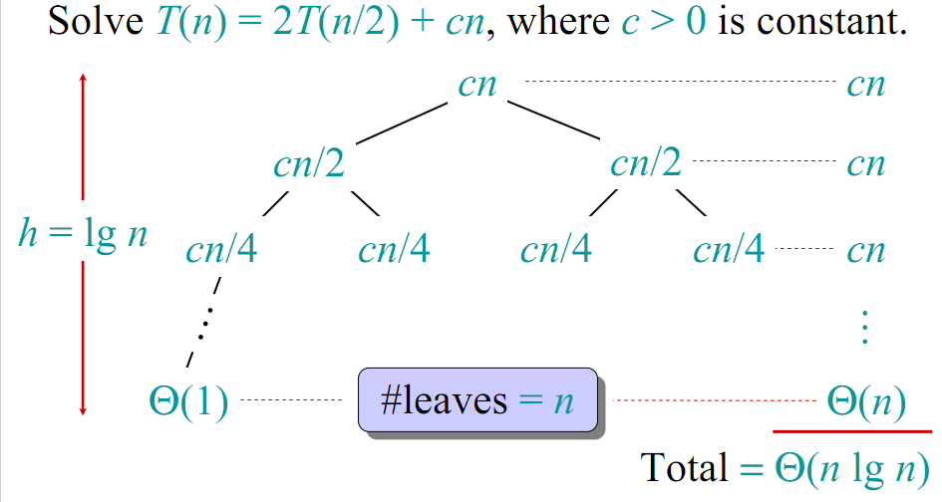
Visual Representation of the Recurrence for Merge Sort

Slide 35
Time Complexity (Using Master Theorem)
Recurrence Relation
T(n)=2T(n/2) + n
Using Master Theorem applying case 2:
So time complexity is O(nlogn)

Slide 36
Θ(nlgn) grows more slowly than Θ(n²)
Therefore, merge sort asymptotically beats insertion sort in the worst case.
In practice, merge sort beats insertion sort for n >=3

Slide 37
Sorting algorithms
Selection and bubble sort have quadratic best/average/worst-case performance
Insertion sort has quadratic average-case and worst-case performance
The faster comparison based algorithm ?
O(nlogn)
Mergesort and Quicksort

Slide 38
Solving Recurrences
The substitution method
A.k.a. “making a good guess method”
Guess the form of the answer, then use mathematical induction to find the constants and show that the solution works
Example:
T(n) = 2T(n/2) + n → T(n) = O(n lg n)

Slide 39
https://opendsa-server.cs.vt.edu/embed/mergesortAV
https://www.youtube.com/watch?v=4V30R3I1vLI&ab_channel=AbdulBari

